Slide 1
TABLE OF CONTENTS
Introduction
Literature Review
Problem identification
Module Description
Parameters Analyzed
Results & Discussion
Conclusion
References

Slide 2
INTRODUCTION
Wind energy is the most efficient technology for producing electricity in a safe and environmentally sustainable manner.
In this project, we implement fault analysis and monitoring system for a Small-Scale wind turbine using NodeMCU.
For doing this project, we use the sensors like Temperature sensor and IR Sensor that helps in finding some of the faults in Wind Turbine Systems
The sensed parameters are monitored in real time using the cloud management technique. For this, ThingSpeak application is used. By using this the concerned person can read the data from anywhere and at anytime.

Slide 3
LITERATURE REVIEW
Srinivasa Reddy et al.., presented a paper on DIAGNOSIS OF FAULT AND MONITORING OF SMALL WIND TURBINE USING ARDUINO. They use an Arduino Uno to construct a problem patient monitoring system for small wind turbines simulation. The Arduino Uno, microcontroller board that uses the ATmega168 or ATmega328 microcontrollers. The ATmega328 is used in this project. Think Speak is an API (Application Programming Interface) for IoT that also functions as a web service. They used this to create programmes for clients based on data obtained from sensors, which aids in real-time data collecting, data processing, and user-friendly presentation. They communicated through telegram, a cloud-based text messaging service. Telegram is common in the business world of small-scale applications.

Slide 4
R.Tharini et al.., presented a paper on FAULT DIAGNOSIS OF WIND TURBINE PLANETARY GEARBOX WITH IOT . In this study, condition monitoring and diagnostics with fault diagnosis being a crucial tool for detecting problems is performed. For the goal of measurement validation, they created detection and isolation strategies for sensor calibration drifts. The gearbox issue is the most common fault in wind turbines.
The wireless sensor was used for signal acquisition, and a piezoelectric vibration energy harvester was used to secure the wireless sensor's energy supply. As a result, the suggested approach has the best diagnostic; it also has strong application potential. The outcome gives technicians early warnings, improves equipment performance, and reduces wind turbine system downtime

Slide 5
S. Kalaivani et al. presented about IOT BASED SMART AND EFFICIENT WIND TURBINE MONITORING SYSTEM. The literature studies on fault information augmentation from complex interruptions and operating mode impacts removal are summarised for signal processing techniques discussed in Section 3. The experiments on feature extraction and fault diagnostic technique are summarised in Section 4. Finally, numerous open research issues for the future are presented and addressed. They sought to examine existing methodologies in terms of their use in the planetary gearbox failure diagnostics by describing the problems they solved and how they handled them.

Slide 6
PROBLEM IDENTIFICATION :
We are taking most of the renewable energy through wind turbine.
In that, human intervention is higher. For fault diagnosis, human presence is needed in that turbine installation.
To reduce the human intervention we are moving to automatic fault diagnosis in wind turbine using Internet of Things.

Slide 7
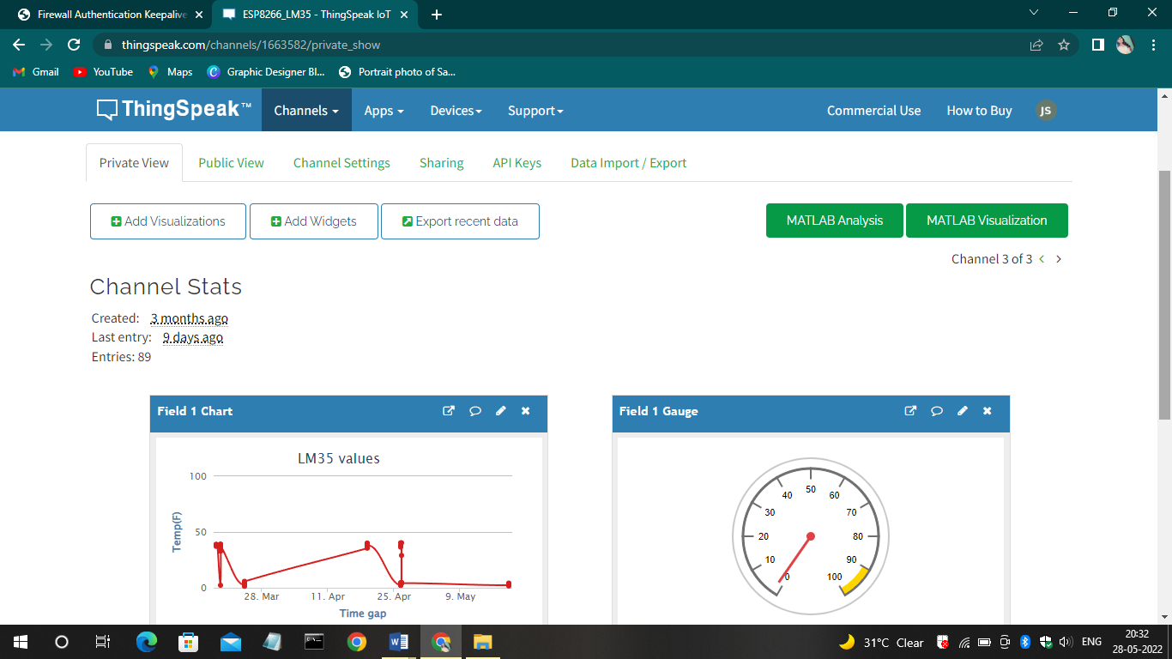
MODULE DESCRIPTION
ThingSpeak
ThingSpeak is a cloud-based IoT analytics tool that lets you aggregate, visualise, and analyse live data streams. ThingSpeak provides real-time visualisations of data sent to the platform by your devices.

Slide 8
The programming conditional expression "if this, then that" inspired IFTTT. The "this" element of an applet is the trigger. They are the things that make the action happen. You can get a notification based on a keyword or phrase from an RSS feed, for example.An applet's activities are the "that" component. They are the outputs that result from the trigger's input.
Triggers and Actions are used to create Applets (previously known as recipes). If you like a photo on Instagram (trigger), for example, an IFTTT app can transfer the image to our Dropbox account (action). Components are basic data provided from a trigger—for example, topic, body, attachments, received date, and sender's address from an email trigger.
IFTTT

Slide 9
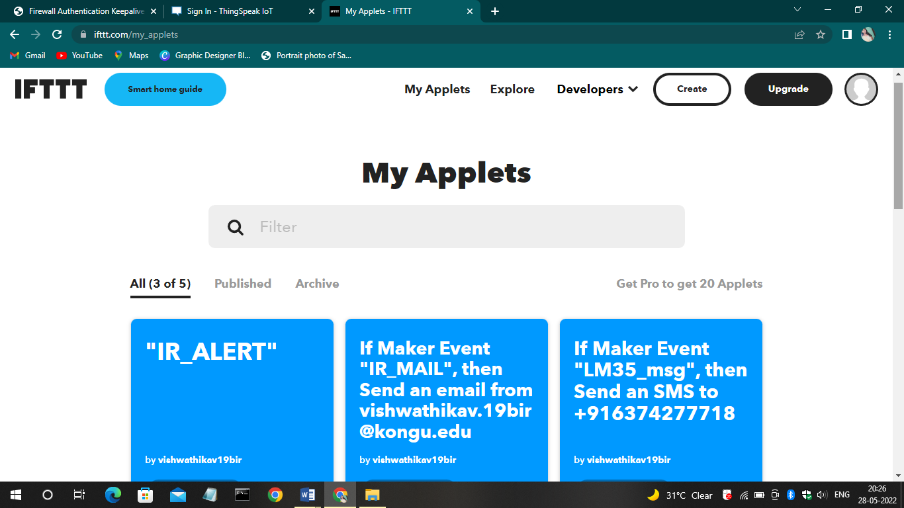
If This Then That

Slide 10
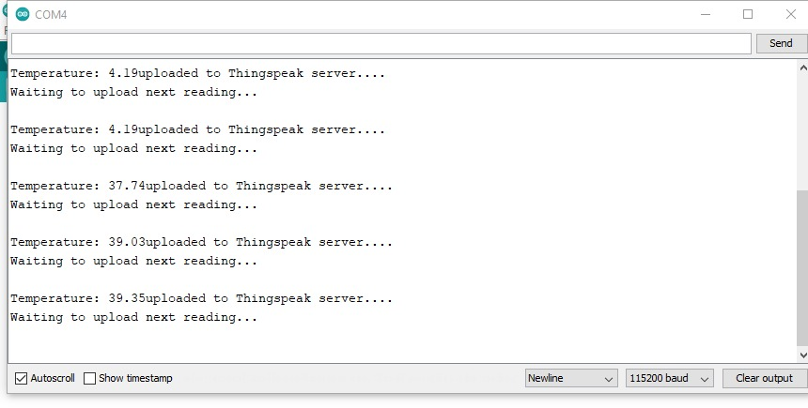
MODULE DESCRIPTION
INTERFACING LM35 WITH NODEMCU:
The LM35(Temperature Sensor) is interfaced with NodeMCU and the output in serial monitor is shown below.

Slide 11
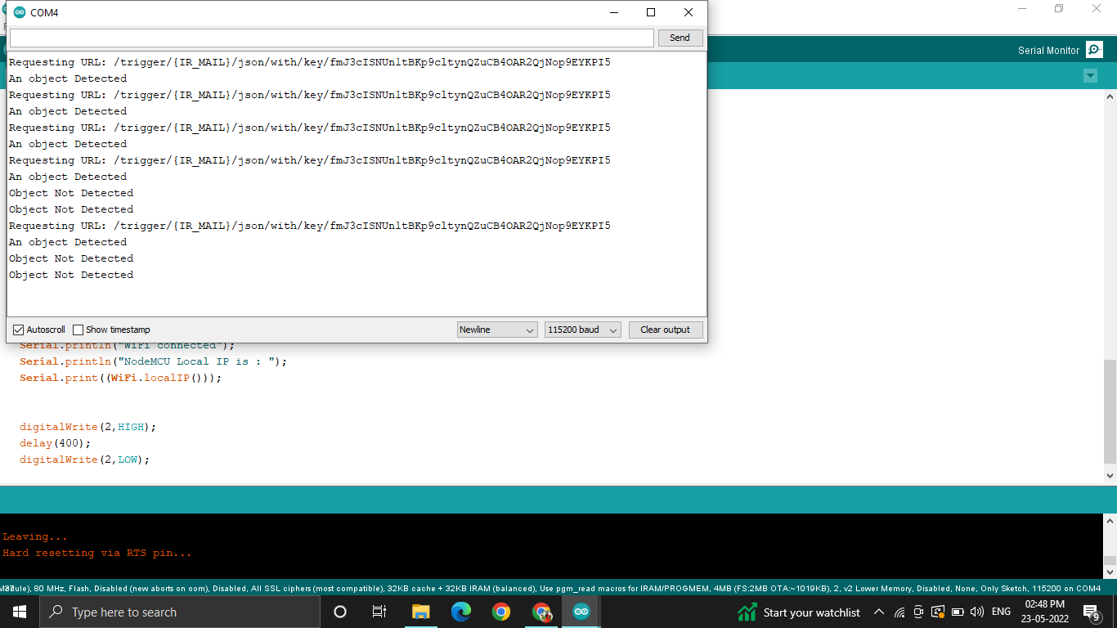
INTERFACING IR SENSOR WITH NODEMCU:
The IR(Infrared)is interfaced with NodeMCU and the output in serial monitor is shown below.

Slide 12
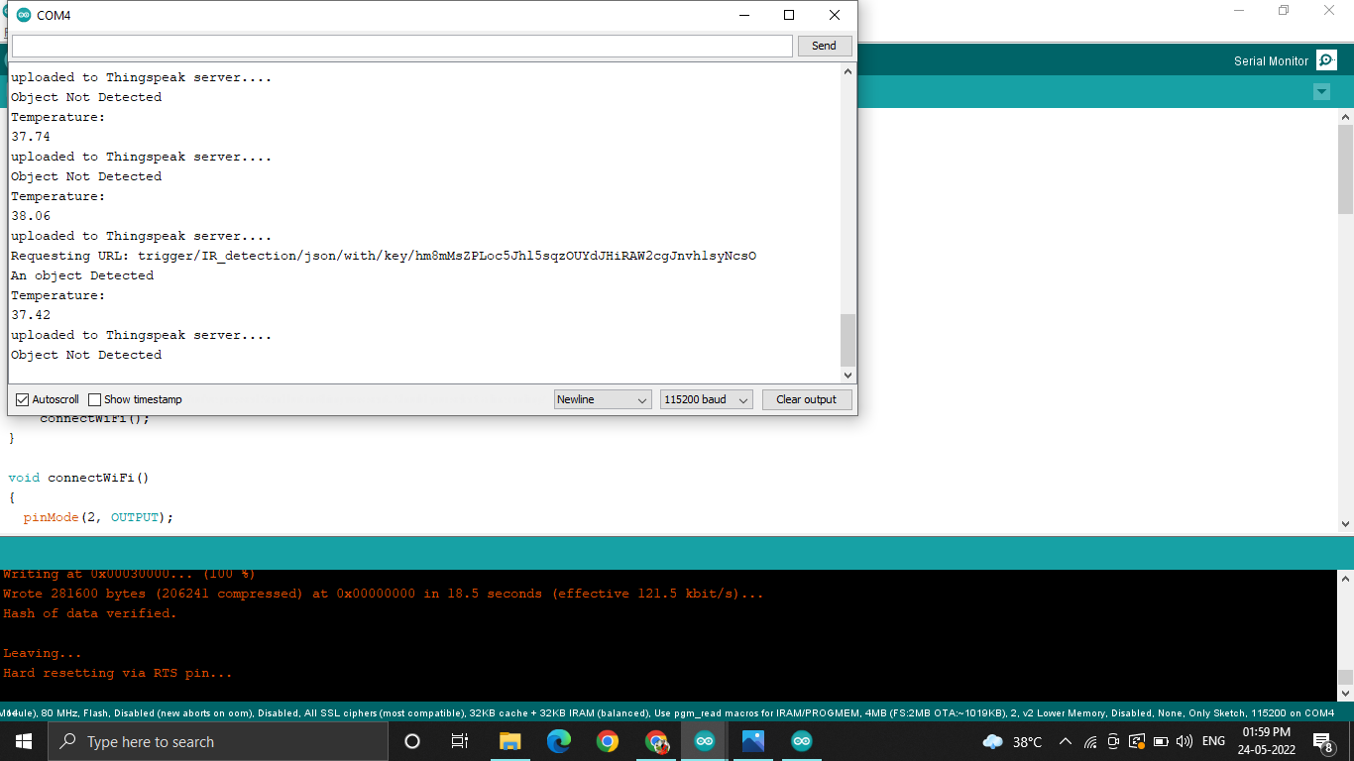
6.3 INTEGRATION OF LM35 AND IR SENSOR WITH NODEMCU:
The LM35(Temperature Sensor) and IR sensor is interfaced with NodeMCU and the output in serial monitor is shown below.

Slide 13
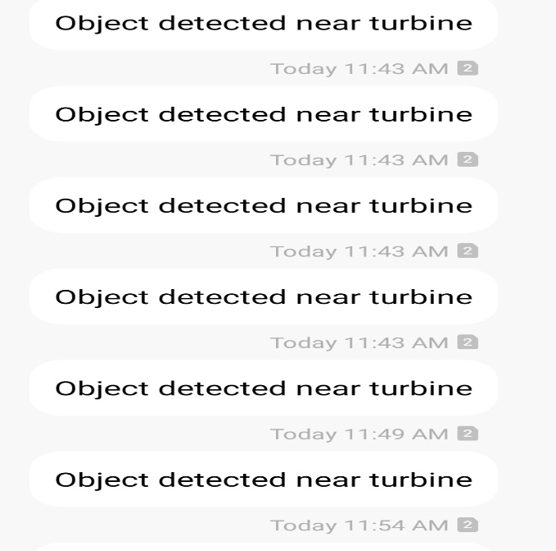
SMS OF IR SENSOR VALUES:
The IR(Infrared) sensor is interfaced with NodeMCU and the values are uploaded to the cloud. If any object is found near the turbine, it is sent as SMS to the concerned Person.

Slide 14
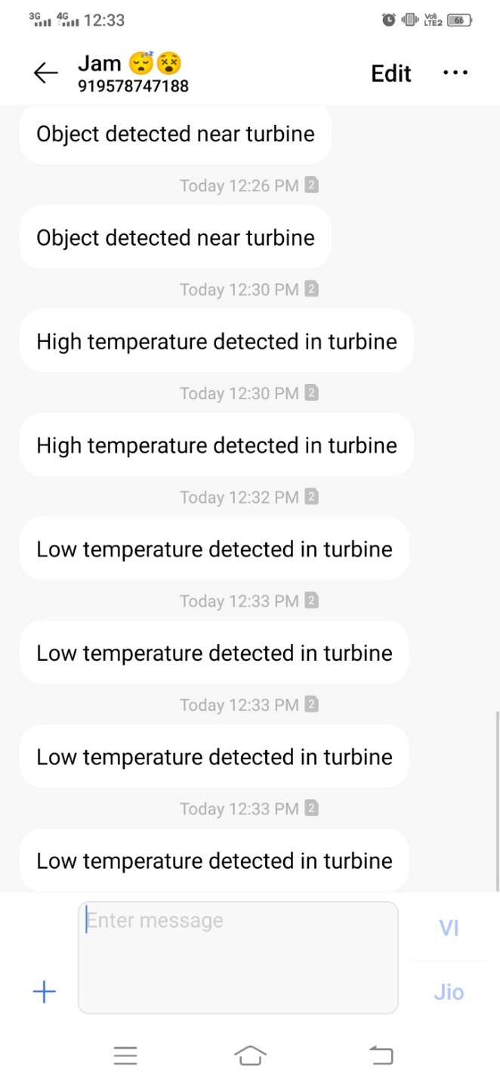
SMS OF LM35 VALUES:
The LM35(Temperature sensor) is interfaced with NodeMCU and the values are uploaded to the cloud. If any abnormal values like low temperature or high temperature is found, the alert message will be sent as SMS to the concerned person.

Slide 15
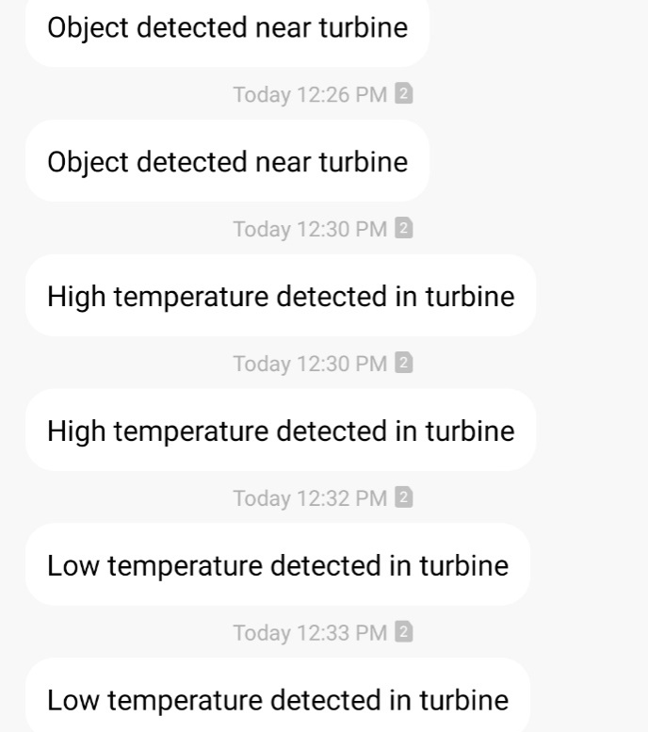
OUTPUT :
LM35(Temperature Sensor) and IR(Infrared) Sensors are integrated with NodeMCU and the sensor values are updated to the cloud (ThingSpeak). If any abnormal sensor values are found, it will be sent as SMS to the concerned person using IFTTT(If This Then That).

Slide 16
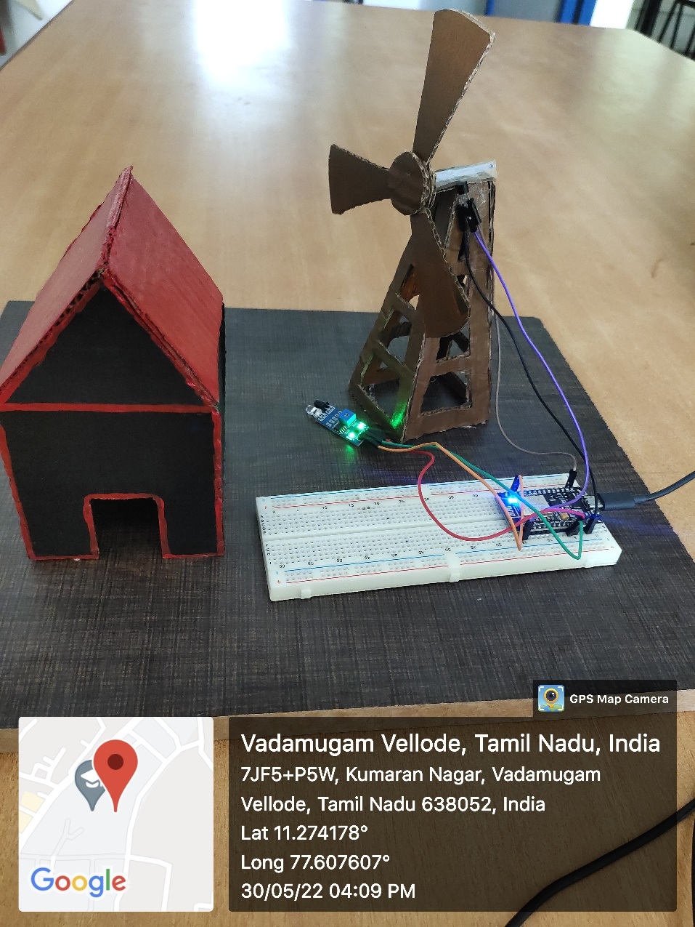
PROTOTYPE MODEL

Slide 17
CONCLUSION
In this project, we have integrated several sensors like IR and LM35(Temperature) with NodeMCU which is a microcontroller as well as Wi-Fi module . After Connecting with the Wi-Fi , the sensor values has been updated to the cloud storage called ThingSpeak in which we can able to moniter the sensor data at anytime and at anywhere. By using IFTTT platform an SMS has been sent to the concerned user if the sensors find any crirical value changes in the wind turbine.
FUTURE ENHANCEMENT
In Future, Additional sensors (Acoustic sensor) can be integrated to moniter the extra parameters that is necessary to be monitored in certain areas (Either in Onshore or Offshore).

Slide 18
REFERENCES
S. Kalaivani, C. Tharini, A.M. Azarudeen and R. Karthikeyan (2021) “IoT BASED SMART AND EFFICIENT WIND TURBINE MONITORING SYSTEM”.
2. Safdar Hussaina , Beenishb , Anup Simeonc , Nayana. N. Patild , Humaira Alie and Abdul Amir Sohel (2021) “ Wind Turbine for Power Generation and Storage by Vehicular Movement on Highways with IoT “ Turkish Journal of Computer and Mathematics Education Vol.12 No.13 (2021), 311-318.
3. Ayse Gokcen Kavaz and Burak Barutcu (2018) “Fault Detection of Wind Turbine Sensors Using Artificial Neural Networks” Hindawi Journal of Sensors Volume 2018, Article ID 5628429.
4. Fran lizza.M1 , Anitha.S2 and R.Raj Mohan (2017) “IoT BASED WIND TURBINE MONITORING, FAULT DIAGNOSIS AND CONTROL USING UART” International Journal of Advanced Research in Management, Architecture, Technology and Engineering (IJARMATE) Vol. 3, Special Issue 6.

